Slide 1
Analysis of Current Trends in Software Development
Trend | Trend Name | Description | Why is it Happening? | Expected Impact
Trend 1 | DevOps | Integrates development and operations teams to streamline software delivery. | Pressure to speed up releases, improve quality, and foster collaboration between teams. | faster deployment cycles, reduced costs, higher-quality software. better alignment between development and operations teams.
Trend 2 | Blockchain Technology | Provides decentralized and secure transaction records. | Increasing demand for transparency, security, and tamper-proof systems across industries. | Cost reduction in transactions, reduced fraud, revolutionizes data storage and financial systems.
Trend 3 | Artificial Intelligence(AI) | Uses machine learning, deep learning, and NLP to automate tasks and create intelligent systems. | Exponential growth in data, computing power, and demand for automation and smarter systems. | Enhanced productivity, reduced human error, faster decision-making, and better user experiences across applications.
Trend 4 | Big Data | handling, processing, and analysis of massive datasets that are too large or complex for traditional data-processing methods. | growth of digital platforms, IoT devices, and social media generates vast amounts of data, creating the need for advanced tools to derive actionable insights. | lead to more data-driven decisions, personalized services, improved operational efficiency, and innovative business models.
Trend 5 | Information Security | Focus on protecting data and ensuring security across platforms. | Increasing cyber threats, regulatory pressure, and data breaches. | Enhanced data protection, better regulatory compliance, and reduced security risks.
Trend 6 | Low-Code/No-Code Platforms | Simplifies application development by enabling non-technical users to build apps. | Need for faster app development and democratization of development. | Quicker time-to-market, reduced dependency on developers, and greater accessibility in app creation
Trend 7 | MLOps | Automates the deployment, monitoring, and management of machine learning models. | Growth of AI, the need to operationalize models, and streamline ML processes. | Improved model accuracy, faster time-to-deployment, and more efficient workflows between teams.
Trend 8 | UX Design | Focuses on creating intuitive, user-centered design for digital products. | Increasing demand for seamless, engaging, and accessible digital experiences. | Better customer satisfaction, higher engagement, and improved product adoption.
Trend 9 | Edge Computing | Processes data closer to where it's generated, reducing latency. | Explosion of IoT devices and demand for real-time data processing. | Reduced latency, increased efficiency, and improved reliability, especially in remote or connected environments.
Trend 10 | Quantum Computing | Uses quantum mechanics to perform complex computations. | Potential for solving problems traditional computers can't, and major investments in research. | Revolutionizing fields like cryptography, AI, drug discovery, and materials science.

Slide 2
Impact of Key Trends on a Real-World Project
Project Title
Project Description
Process Description – How was the Project Done?
Predicting Student Performance
The project will accomplish:
Early identification of at-risk students, enabling timely interventions.
Personalized learning and support, improving student performance.
My role:
Develop and refine AI/ML models for predicting student performance.
Integrate predictive models into the system for real-time insights.
Major steps: collecting and preparing student data, developing and evaluating predictive models, integrating them into a real-time system, deploying with CI/CD, designing user-friendly dashboards, and continuously refining the system based on feedback.
Tools used: Python, R, TensorFlow, Scikit-Learn, Hadoop, SQL/NoSQL, Git, Jenkins, Tableau, and AWS/Google Cloud for data processing, machine learning, deployment, and visualization.
Methodology used: Agile Methodology
What key trends influenced your project? | How? | What was the impact?
Artificial Intelligence | Predictive modeling, NLP for sentiment analysis of student feedback | More accurate predictions, personalized interventions, improved academic outcomes
Machine Learning | Continuous learning, clustering, and classification to analyze student data | Improved accuracy of predictions over time, real-time adaptations based on new data
Big Data | Aggregating and processing large datasets from multiple sources (grades, attendance) | Scalable data processing, comprehensive insights, identifying hidden patterns in student behavior

Slide 3
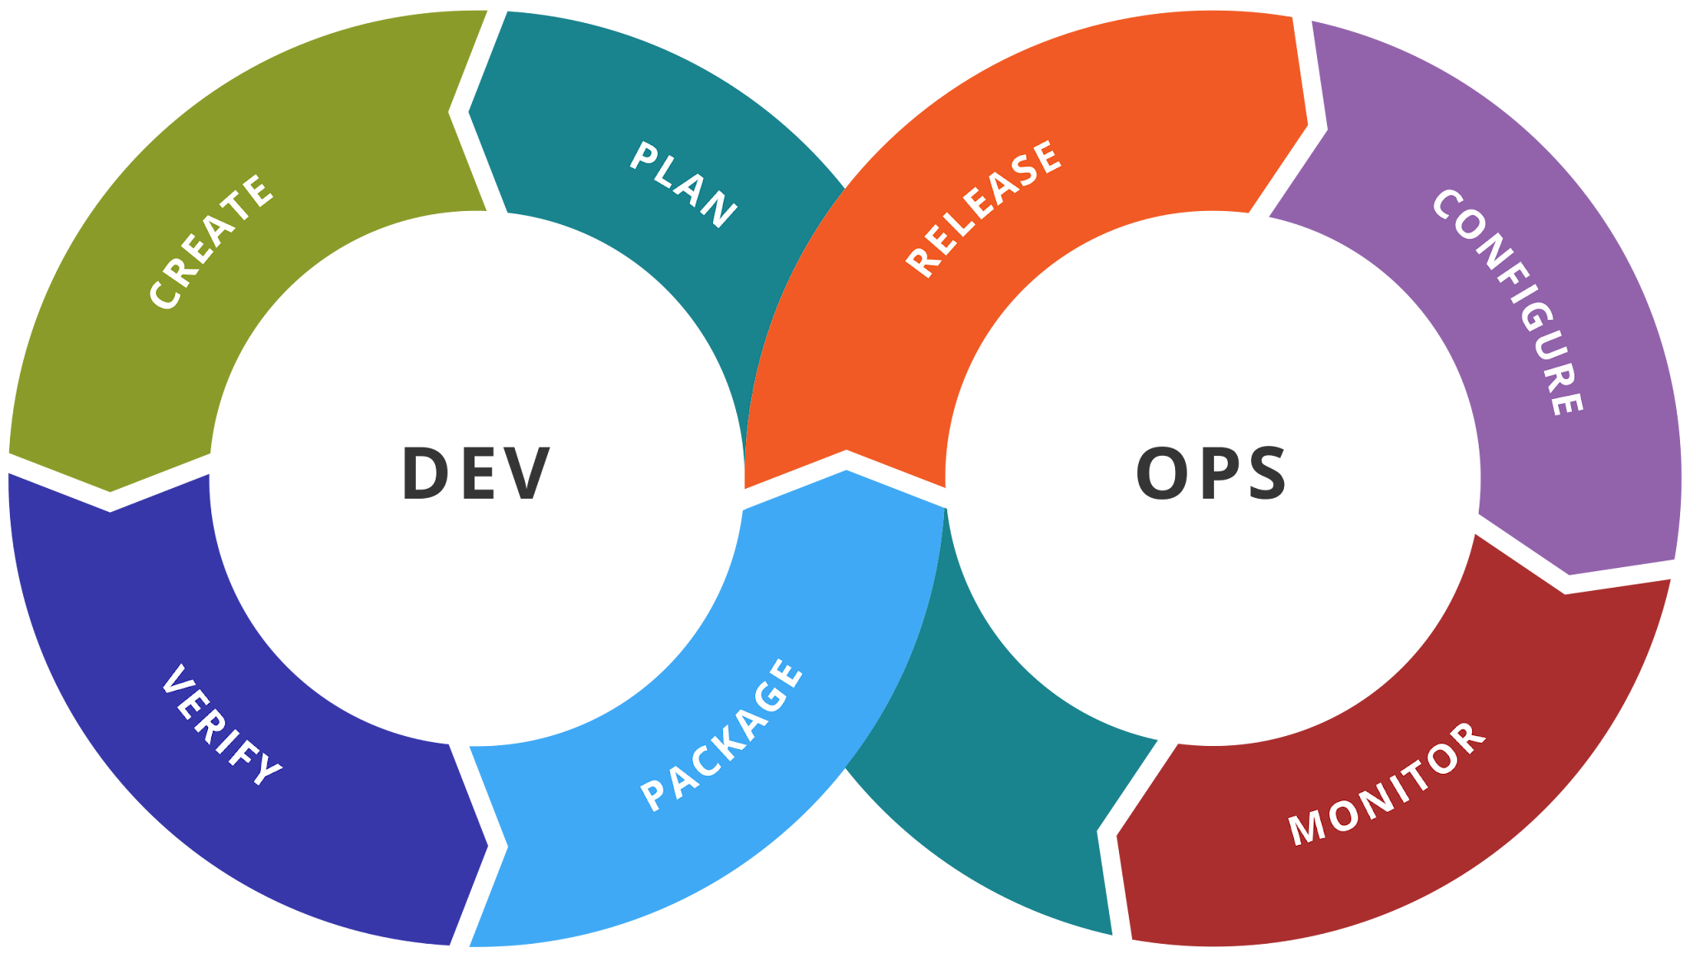
DevOps
Description:
Integrates development and operations teams to streamline software delivery.
Why is it happening?
Pressure to speed up releases, improve quality, and foster collaboration between teams.
Expected Impact:
Faster deployment cycles, reduced costs, improved collaboration, and higher-quality software.
Real-time Projects/Applications:
GitLab
Netflix

Slide 4
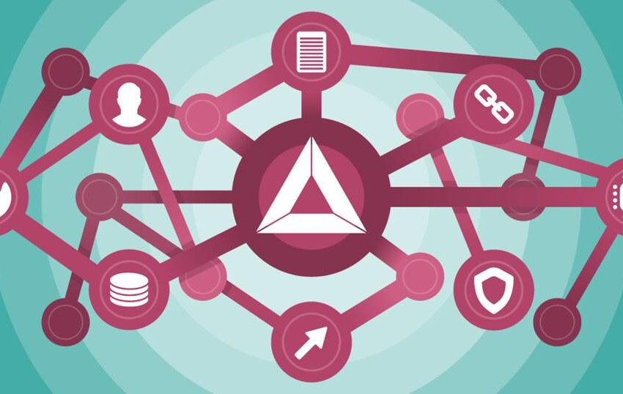
Blockchain Technology
Description:
Provides decentralized and secure transaction records.
Why is it happening?
Increasing demand for transparency, security, and tamper-proof systems across industries.
Expected Impact:
Cost reduction in transactions, reduced fraud, revolutionizes data storage and financial systems.
Real-time Projects/Applications:
Ethereum
Bitcoin

Slide 5
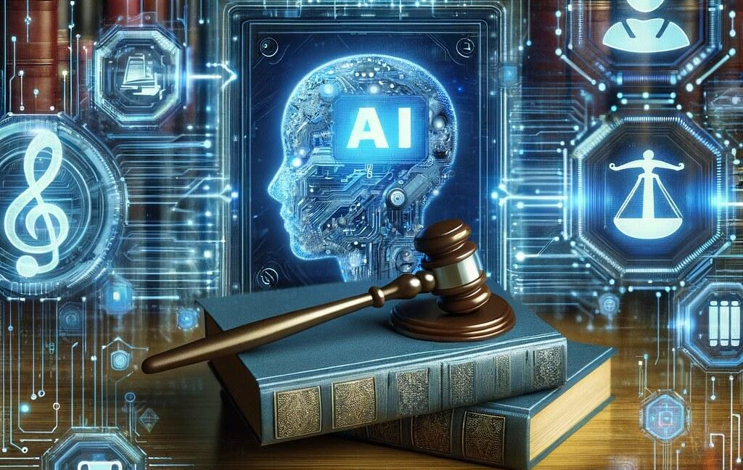
Artificial Intelligence
Description:
Uses machine learning, deep learning, and NLP to automate tasks and create intelligent systems.
Why is it happening?
Exponential growth in data, computing power, and demand for automation and smarter systems.
Expected Impact:
Enhanced productivity, reduced human error, faster decision-making, and better user experiences across applications.
Real-time Projects/Applications:
Google Assistant
ChatGPT

Slide 6
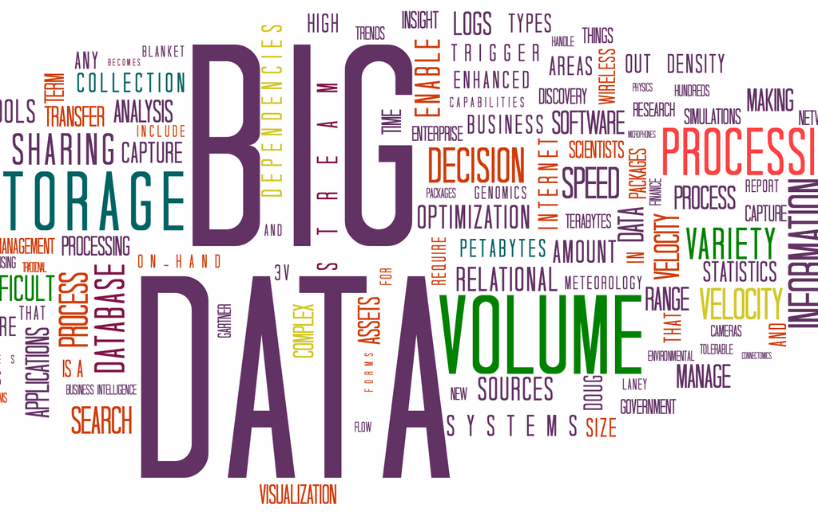
Big Data
Description:
Handling, processing, and analyzing massive datasets for actionable insights.
Why is it happening?
Explosion of data from digital platforms, IoT devices, and social media.
Expected Impact:
Data-driven decisions, personalized services, and improved operational efficiency.
Real-time Projects/Applications:
AWS Big Data
Google Analytics

Slide 7
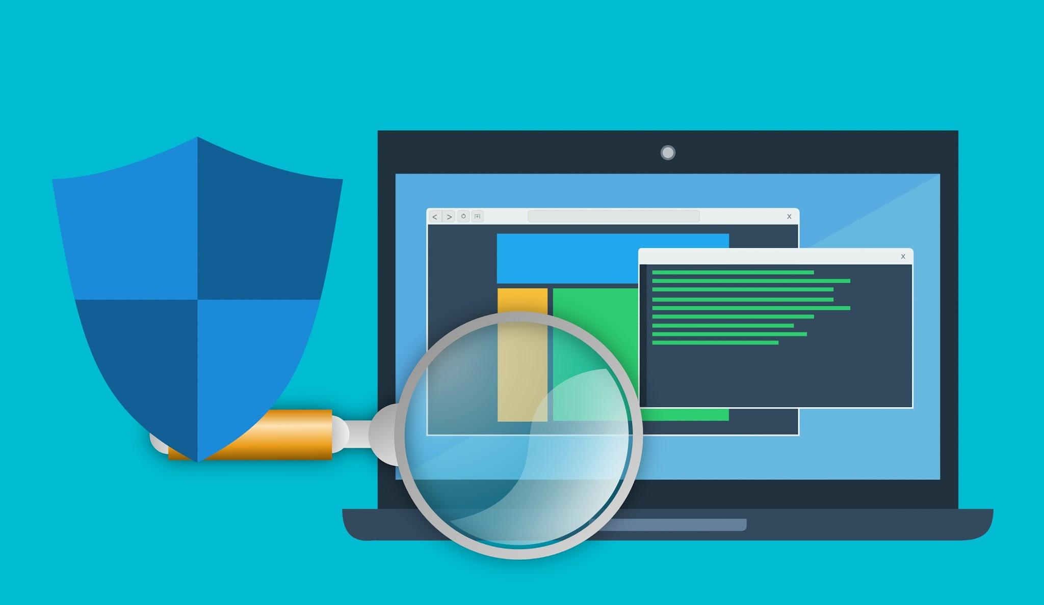
Information Security
Description:
Focus on protecting data and ensuring security across platforms.
Why is it happening?
Increasing cyber threats, regulatory pressure, and data breaches.
Expected Impact:
Enhanced data protection, better regulatory compliance, and reduced security risks.
Real-time Projects/Applications:
CrowdStrike
Okta

Slide 8
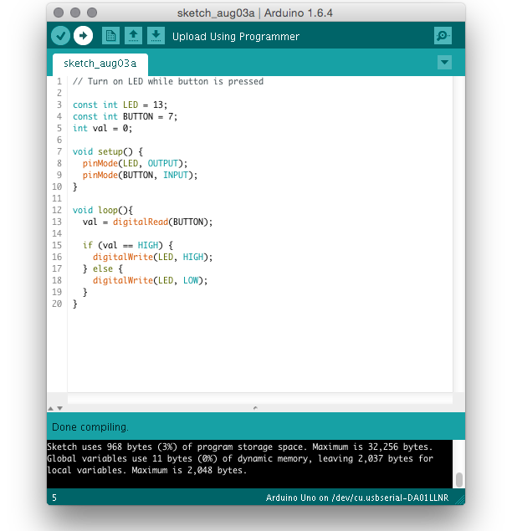
Low-Code/No-Code Platforms
Description:
Simplifies application development by enabling non-technical users to build apps.
Why is it happening?
Need for faster app development and democratization of development.
Expected Impact:
Quicker time-to-market, reduced dependency on developers, and greater accessibility in app creation
Real-time Projects/Applications:
Appian
Appsmith

Slide 9
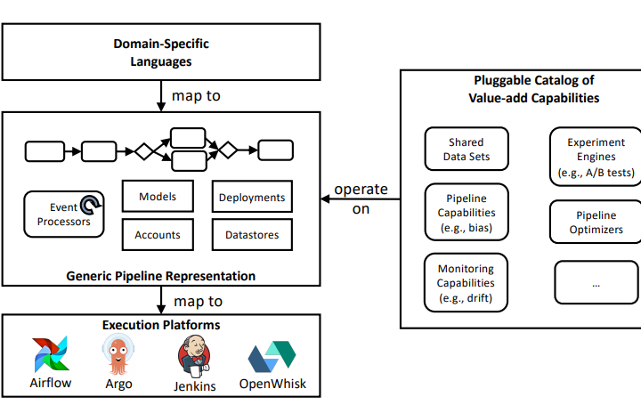
MLOps
Description:
Automates the deployment, monitoring, and management of machine learning models.
Why is it happening?
Growth of AI, the need to operationalize models, and streamline ML processes.
Expected Impact:
Improved model accuracy, faster time-to-deployment, and more efficient workflows between teams.
Real-time Projects/Applications:
Google Cloud AI Platform
Azure Machine Learning

Slide 10
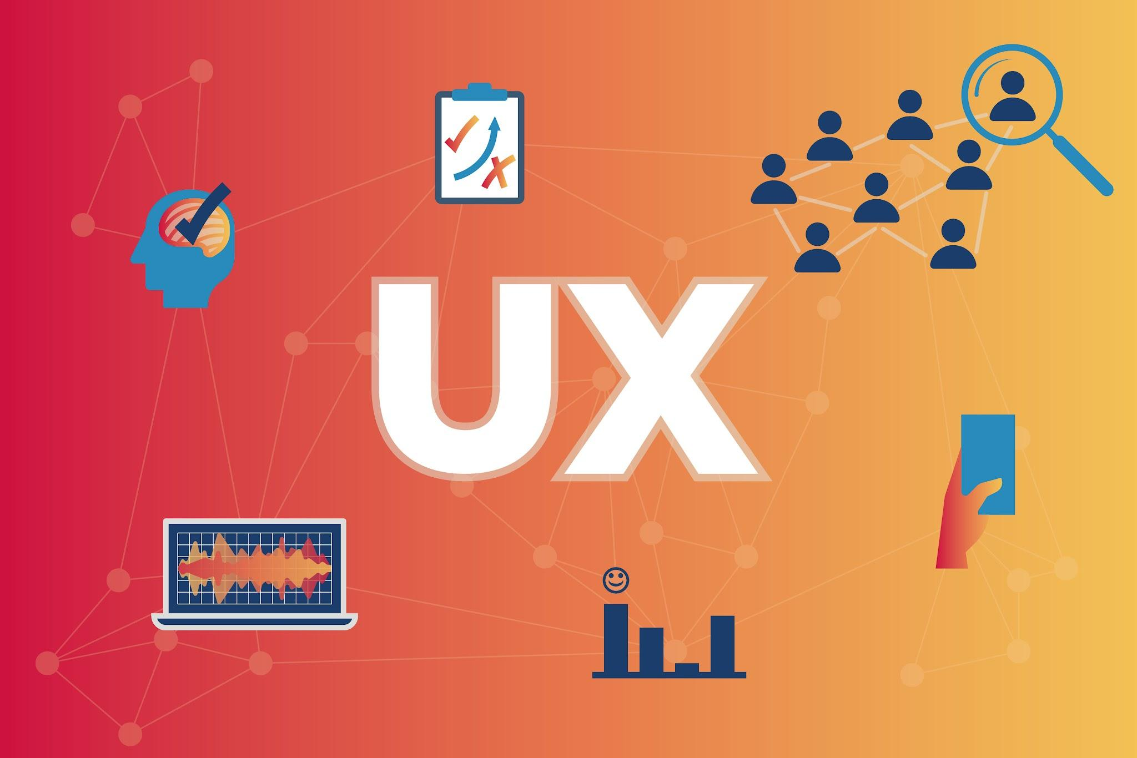
UX Design
Description:
Focuses on creating intuitive, user-centered design for digital products.
Why is it happening?
Increasing demand for seamless, engaging, and accessible digital experiences.
Expected Impact:
Better customer satisfaction, higher engagement, and improved product adoption.
Real-time Projects/Applications:
Apple iOS
Spotify

Slide 11
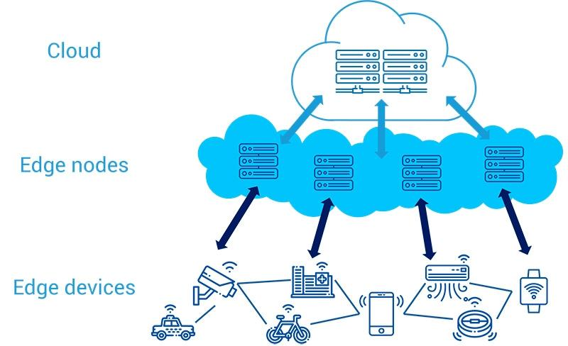
Edge Computing
Description:
Processes data closer to where it's generated, reducing latency.
Why is it happening?
Explosion of IoT devices and demand for real-time data processing.
Expected Impact:
Reduced latency, increased efficiency, and improved reliability, especially in remote or connected environments.
Real-time Projects/Applications:
Cisco IoT Edge
Tesla Autopilot

Slide 12
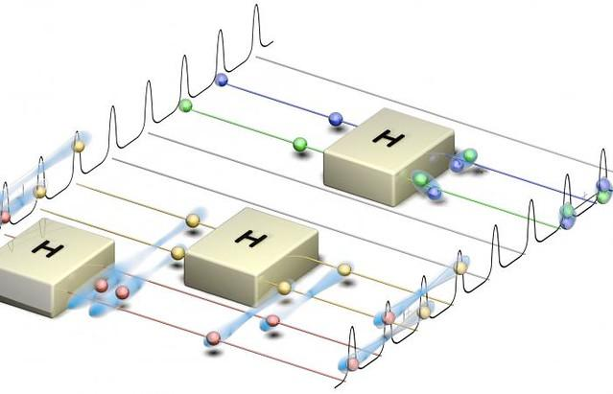
Quantum Computing
Description:
Uses quantum mechanics to perform complex computations.
Why is it happening?
Potential for solving problems traditional computers can't, and major investments in research.
Expected Impact:
Revolutionizing fields like cryptography, AI, drug discovery, and materials science.
Real-time Projects/Applications:
IBM Quantum
Google Sycamore

